Slide 1

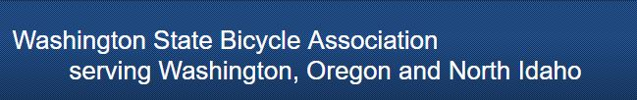
2017 Annual Meeting Agenda
Introductions
Overview of the WSBA
Richard Smith, Executive Director of Cascade Bicycle Club
2017 Financial Review
2017 Program Recap
Elections for Board of Directors
2018 Program Additions
2017 BARR Awards
General Q&A

Slide 2
About the WSBA:
Revenue comes from USAC, WSBA memberships, and donations.
Primary expenses annually include replacing equipment, championship jerseys, and bib and frame numbers.
We seek out sponsorship to offset expenditures.
We pay nominal stipends to individuals who manage significant time-consuming tasks.
We conduct regular board calls (meetings) every 4-6 weeks. We review our finances vs budget at least quarterly if not monthly.
We are constantly trying to find new ways to support competitive cycling in our region regardless of discipline and/or relation to USAC.

Slide 3

Richard Smith
Executive Director of Cascade Bicycle Club

Slide 5
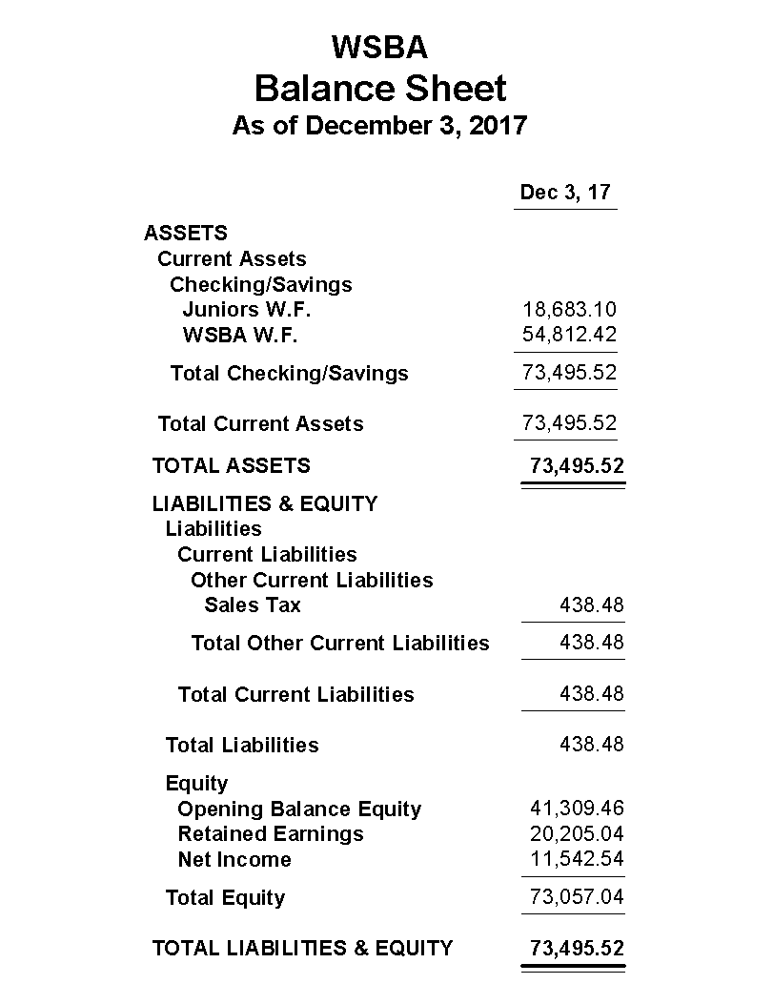

Slide 6
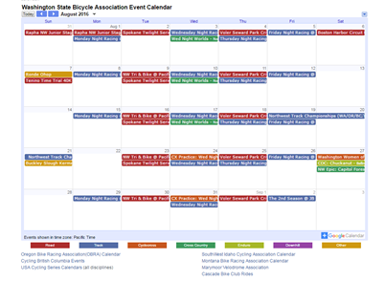
WSBA Calendar
Competitive cycling events held within the Washington, North Idaho, and Oregon borders of the WSBA that are not sanctioned by another local association or governing body are listed on the WSBA calendar. The calendar includes road, track, cyclocross, cross country, enduro, downhill, and other cycling events.

Slide 7
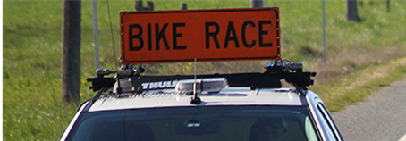
WSBA Equipment Rental Program and
Fee Discount
The WSBA provides equipment rental for races of all kinds and sizes. We offer rental fee discounts for qualifying events:​
50% off standard rental fees for an event that offers 3 or more junior or women’s categories run separately within the race day schedule and/or is a new event within the WSBA region that:
  Uses a venue/park/locale that has never previously hosted a competitive cycling event;
  Uses a venue/park/locale that has not hosted a competitive cycling event in the last 2 years; or
  Is an existing event that opts for USAC sanctioning for the current year and has not been USAC sanctioned in the previous 2 years.
100% off standard rental fees for an event designated as a WSBA championship.

Slide 8

WSBA New
Event Subsidies
The New Event Subsidy Program was launched in 2016 to help promoters add new events or evolve existing events which support growth for the WSBA membership and the competitive cycling community as a whole.
Events supported in 2017 include:
  NW CX Cup Series
  Team Thrive Women’s Intro to Racing Clinic and Race day at Pacific Raceways

Slide 9

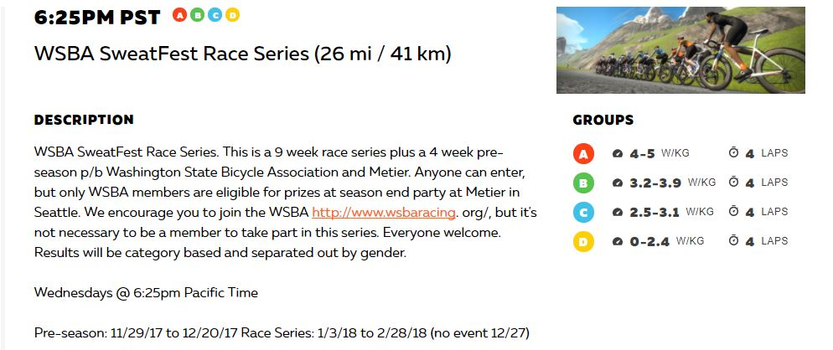
Zwift WSBA SweatFest Race Series P/B Métier Seattle

Slide 10


USAC Beginning Racer Program
In collaboration with the WSBA and USA Cycling, Cycle U offered “learn how to road race” clinics. The goals of this Beginning Racer Program were to help create a safer and larger NW peloton for women, men, and juniors and to teach more people the joys of fast riding in a group or race environment.
In 2017 the WSBA supported participation in this program with a subsidy of the clinic fees for 63 WSBA members. Clinics were typically held at a road race venue so that riders could race immediately after practicing skills in the clinics. Riders
earned USAC upgrade points at each clinic.

Slide 11
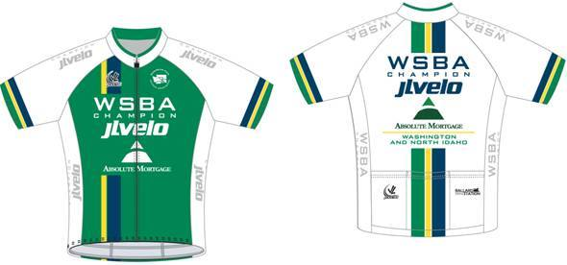


WSBA Championships
Thanks to generous sponsorship from Absolute Mortgage and JL Velo, the category winners at every WSBA championship race this year were awarded a free champion’s jersey at the race finish.
Congratulations to all 2017 WSBA champions!

Slide 12
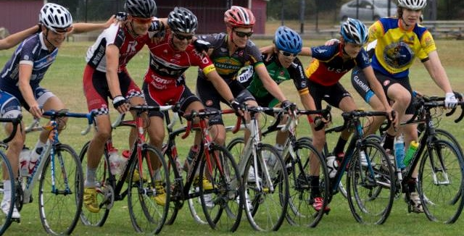
USAC ID Camps for U23 & Juniors
(road and cross)
“I had an amazing time at camp this year. I got to meet many new people and spend time with many friends from past camps. The biggest thing I learned at camp this year is the importance of running stairs or hills to help get quick feet on run ups. Now I regularly do a hill sprint workout. Thank you again for supporting WSBA, your contributions are very appreciated.” Scott Funston
“Thank you members for your support through WSBA. I received grant money to attend a USAC talent ID camp in Colorado Springs. My favorite part was getting to know the people at camp. It was easy relating to each other since we were all cyclists, students, and women.” Jasmine Soh
”The years of wisdom of Geoff Proctor and the other coaches in attendance and the camaraderie built between up and coming junior, and now U23 cross riders is invaluable. Much of what and who I know in cyclocross has come from the Montana Cross Camp and that knowledge and those connections have been invaluable to me in the past several years. It is the generosity of WSBA members that make moments and experiences likes these possible for me and for that I cannot thank you all enough.” Calder Wood

Slide 13
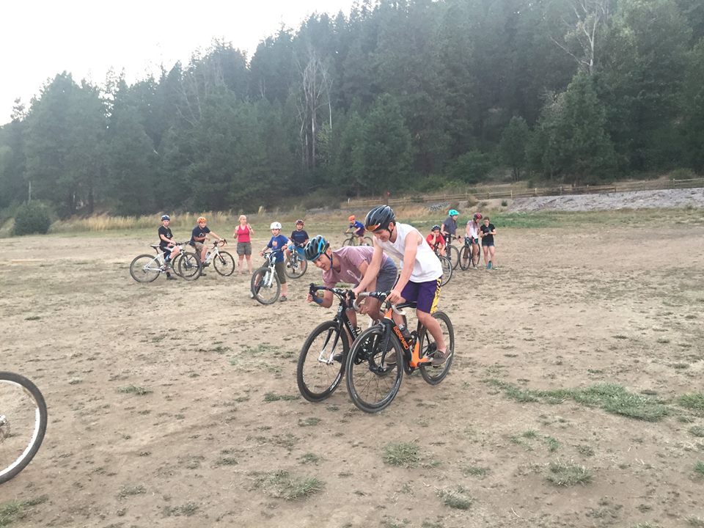
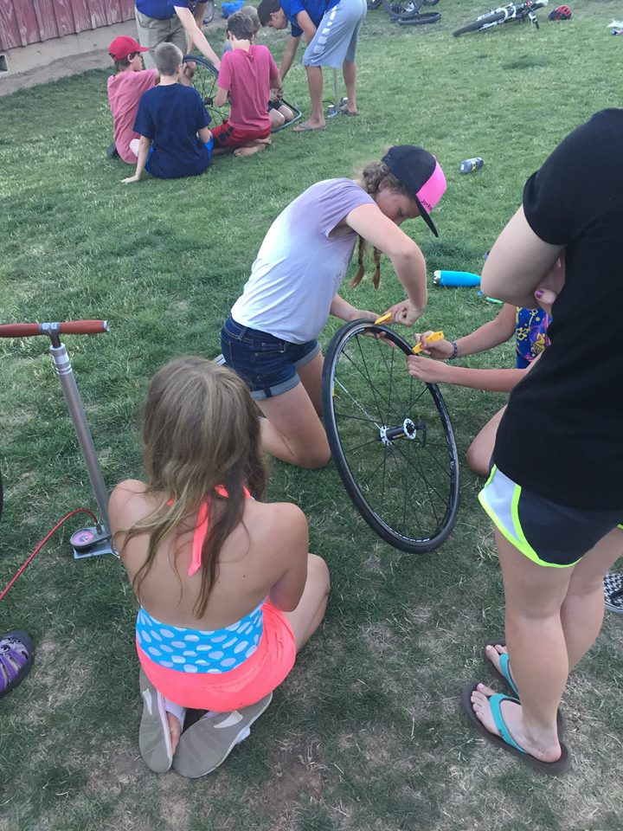
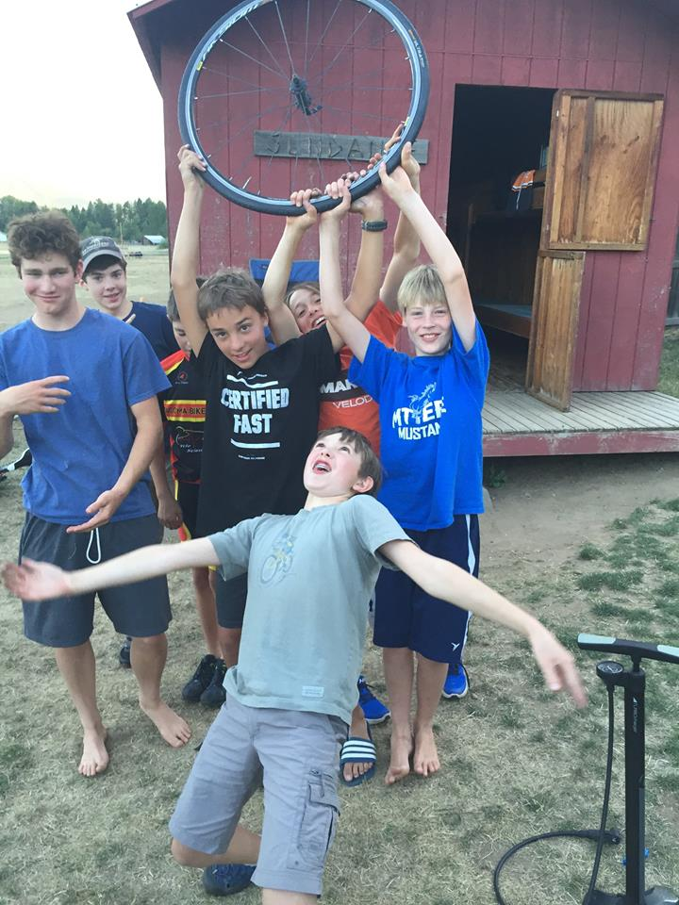
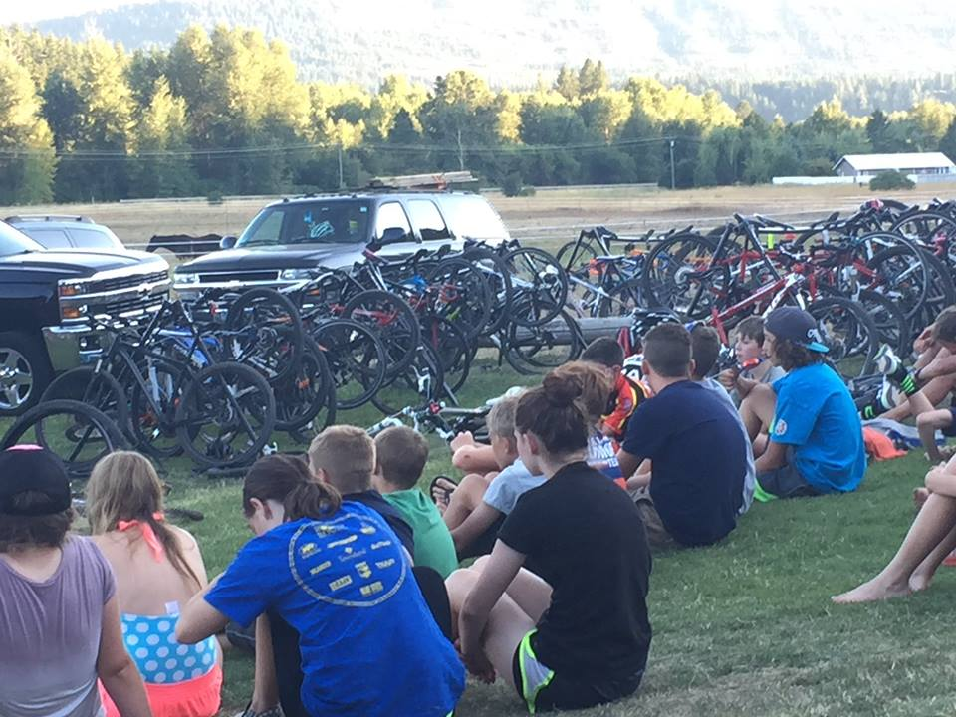
WSBA Larry Kemp Cycling Camp
This annual camp for kids ages 10-14 is funded by donations and registrations.

Slide 14
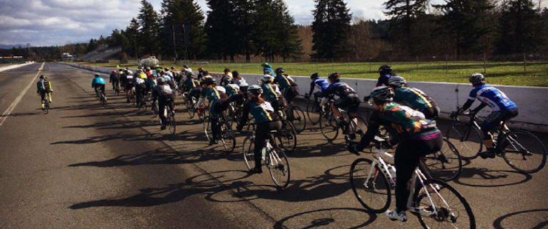

WSBA and
Women’s Racing
A wide range of opportunities for the women’s cycling community are made possible under the WSBA umbrella by many volunteers. In 2017 these included:
New Rider Clinic for Women, February 20:
More than 55 women, including 30 true
beginners (never raced before), turned out
to learn and improve their peloton skills.
Intro to Women’s Cycling and Racing Teams:
These annual women-only rides on
September 10 and 24 introduced new riders
and racers to women’s teams in the
Seattle area.

Slide 15
Board of Director Elections
The Board of Directors has endorsed this slate of candidates for the open board positions:
Junior development coordinator: Heather Nielson
Southwest region representative: David Chipchase
East region representative: Nigel Davies
​Directors on the Board are elected for three-year terms by a vote of the membership (one vote per USAC club in Washington, North Idaho, and Oregon who are present at the meeting), conducted at the annual meeting.

Slide 16
2018 Programs
WSBA Mountain Bike Championship: April 15
USAC sanctioned which allows WSBA members to qualify for MTB nationals.
One-day fees are covered by a WSBA New Event subsidy.
Tour of Walla Walla: April 20-22
Visit WallaWalla is supporting Allegro Cyclery with resources.
WSBA is working with Visit WallaWalla to regain member and community trust.
General
Exploring new website platform options.
Working to integrate Northwest Collegiate Cycling Conference riders into WSBA and standard category racing.
Exploring MTB series options for Northwest Collegiate Cycling Conference.

Slide 17

WSBA Best
All-Around Road Rider Competition
Men cat 1/2 Will Teal Métier Racing
Men cat 3 Justin Wagner Mountain View Racing
Men cat 4 Paul Gilbert Apex Racing
Women cat 1/2 Heidi Franz Keller Rohrback Cycling
Women cat 3 Stephanie Halamek Seattle Cancer Care Alliance
Women cat 4 Allison Indyk Seattle Cancer Care Alliance
Masters men 60+ Tom Potter Olympia Orthopaedic Associates
Masters men 50-59 Sean Phillips Garage Racing
Masters men cat 4/5 40-49 Stewart Ayling Monton-TM
Masters men cat 1/2/3 40-49 Brian Falkowkski Monton-TM
Masters women cat 1/2/3 40+ Annette Williams Kenmore Velo
Masters women cat 4 40+ Lavonne Wilson Team Thrive P/B Kaiser Perm.

Slide 18
Best All-Around Team 2017
Men
1st Place Audi
2nd Place Métier Racing & Coffee
3rd Place Apex Racing
Women
1st Place Team Thrive P/B Kaiser Permanente
2nd Place Velobody/Bikesale
3rd Place Seattle Cancer Care Alliance Cycling

