Slide 1

2016
WSBA Annual Meeting Agenda
Introductions
2016 in Review
  Programs
  Financials
Looking ahead at 2017
New website
Reviewing/updating WSBA Bylaws
BARR
  2017 Dedicated to RC Rogers
  Scoring changes
Race calendar
USAC Updates that May Affect Our Community/Region
Election of Directors
  Vote on director candidates for East, West, Oregon regions. Cyclocross, Track and Official’s representatives
New Business/QA
BARR/BAT/Junior Series Awards

Slide 2
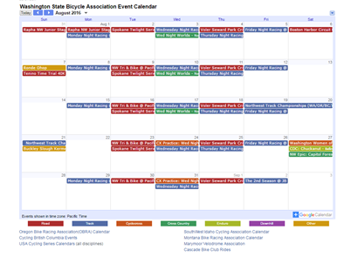
WSBA Calendar
Competitive cycling events held within the Washington, North Idaho, and Oregon borders of the WSBA that are not sanctioned by another local association or governing body are listed on the WSBA calendar. The calendar includes road, track, cyclocross, cross country, enduro, downhill, and other cycling events.

Slide 3
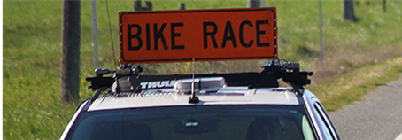
WSBA Equipment Rental Program and Fee Discount
The WSBA provides equipment rental for races of all kinds and sizes. New in 2016 were rental fee discounts for qualifying events:​
50% off standard rental fees for an event that offers 3 or more junior or women’s categories run separately within the race day schedule and/or is a new event within the WSBA region that:
  Uses a venue/park/locale that has never previously hosted a competitive cycling event;
  Uses a venue/park/locale that has not hosted a competitive cycling event in the last 2 years; or
  Is an existing event that opts for USAC sanctioning for the current year and has not been USAC sanctioned in the previous 2 years.
100% off standard rental fees for an event designated as a WSBA championship.

Slide 4

WSBA New
Event Subsidies
The New Event Subsidy Program launched in 2016 helps promoters add new events or evolve existing events which support growth for the WSBA membership and the competitive cycling community as a whole. Growth in the sport happened with the addition of these events receiving subsidies from the WSBA this year:
  Poulsbo Twilight Criterium
  Skagit Flats Circuit Race
  New USAC-sanctioned races at Pacific Raceways
  Take a Girl Mountain Biking Day
  Emerald Time Trial
  WSBA Cyclocross Championship

Slide 5
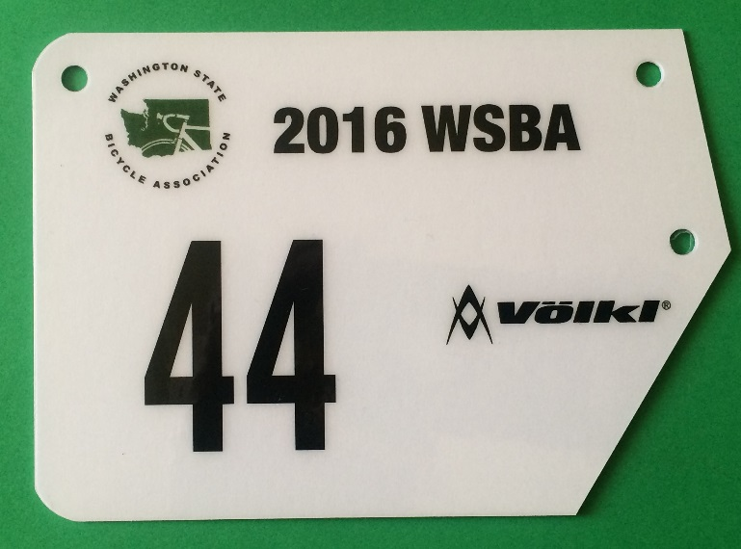
WSBA Number Sponsor
Your 2016 WSBA bib and frame numbers were sponsored by a generous grant from Völkl Skis. In prior years, the WSBA paid approximately $16,000 each year for the bib and frame numbers. This cost broke out as $12.50 per member and constituted 25% of the total WSBA budget in 2015.
This program will continue in 2017.

Slide 6


USAC Beginning Racer Program
In collaboration with the WSBA and USA Cycling, Cycle U offered “learn how to road race” clinics. The goals of this Beginning Racer Program were to help create a safer and larger NW peloton for women, men, and juniors and to teach more people the joys of fast riding in a group or race environment.
The WSBA supported participation in this program with a subsidy of the clinic fees for WSBA members. Clinics were typically held at a road race venue so that riders could race immediately
after practicing skills in the clinics. Riders earned
USAC upgrade points at each clinic.

Slide 7
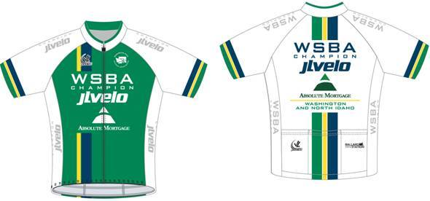



WSBA Championships
Thanks to generous sponsorship from Absolute Mortgage, JL Velo, and Ballard Station Public House, the category winners at every WSBA championship race this year were awarded a free champion’s jersey at the race finish.
Congratulations to all 83 2016 WSBA champions!

Slide 8
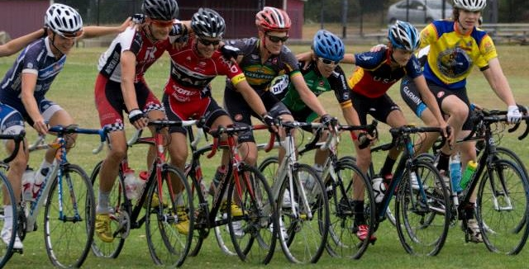
USAC Talent ID Camps for Juniors
(road and cross)
“I had an amazing time at Montana Cross Camp and I'm thankful for the incredible opportunity it was. I walked away with valuable knowledge that will help me during the upcoming season as I make my bid for the world championship team. Thank you for your support.” Scott Funston (now Ranked 35 in World UCI ratings)
“The things that I learned at camp will help me in training, at races, and in my daily life…. Thank you to all the members and sponsors of WSBA for supporting such a great organization. Your support to them gave me the opportunity to go to this camp so thank you all so much.” Gabrielle Lehnert
“I was lucky to get the chance to attend my second USA Cycling Regional Talent ID camp in Forest Grove because of the generous grant from the WSBA and all its members who support it. I feel so fortunate to have participated in the camp and learned each day I spent there.” Keelan Ontiveros
“Thank you to all who support the WSBA with their annual membership. I was granted support to the Talent ID camp in Oregon, which I attended in mid-July. I had a great time learning, meeting new people, and riding bikes! The coaches at the camp discussed a variety of topics, and one interesting session was about junior gearing.” Jasmine Soh

Slide 9
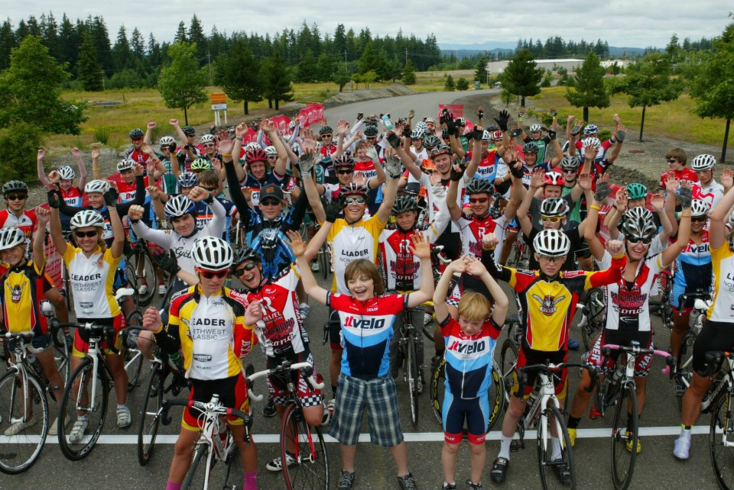
WSBA Junior
Road Development Series
The 2016 WSBA Junior Road Development Race Series was a 9-race points series in the WSBA region, including road races, time trials, criteriums, and stage races. All current WSBA junior members were included in the series.
Two events in the series, the Icebreaker Time Trial and NW Juniors Stage Race, were also part of the national USA Cycling Road Development Race Series (RDRS). The RDRS program promotes quality junior-age bicycle racing while providing opportunities for the success and advancement of developing riders. The program seeks to increase the quantity and quality of USA Cycling licensed junior riders, creating a larger pool of talented athletes from which to draw national team athletes. The program is part of a USA Cycling National Development Athlete Pathway to help riders progress from their beginning racing experiences through training camps to national teams.

Slide 10
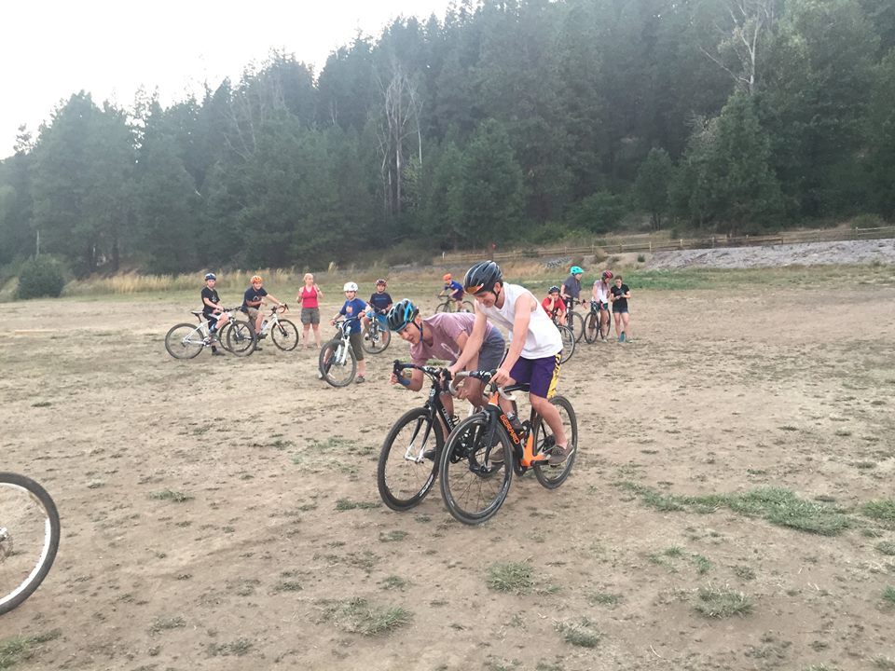
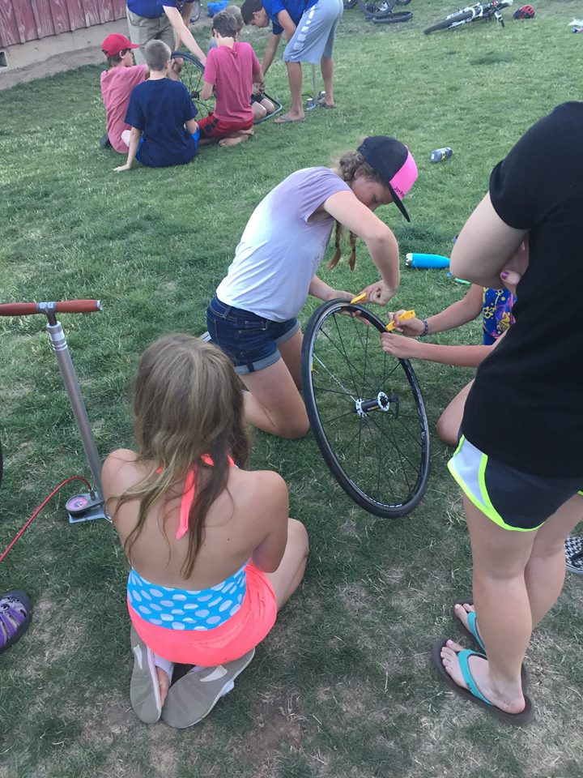
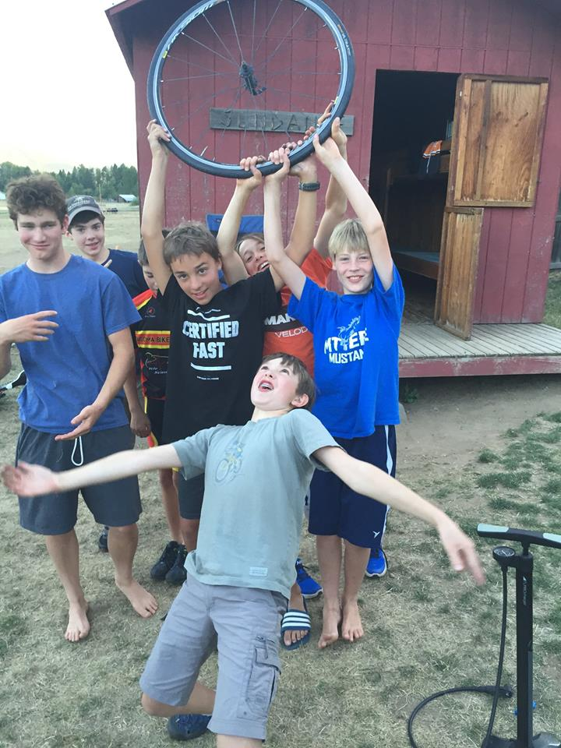
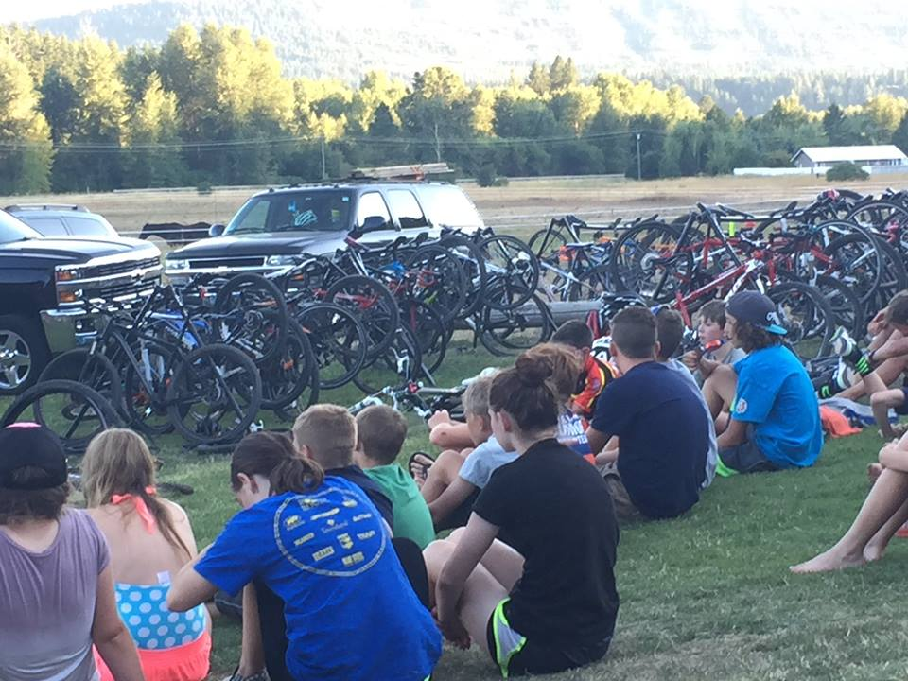
WSBA Larry Kemp Cycling Camp
This annual camp for kids ages 10-14 is funded by donations and registrations.

Slide 11
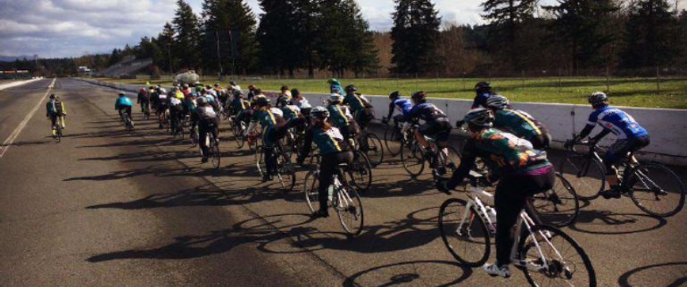

WSBA and Women’s Racing
A wide range of opportunities for the women’s cycling community are made possible under the WSBA umbrella by many volunteers. In 2016 these included:
New Rider Clinic for Women, February 20: More than 55 women, including 30 true beginners (never raced before), turned out to learn and improve their peloton skills.
Racing and coaching clinic for cat 4 women, March 6:
Mason Lake was again the location for a mentored race clinic to
help new AND experienced women racers expand their racing
skills and understanding--and have more fun in the sport.
Cat 3/4 women’s races at Pacific Raceways, June 14 and July 5:
These events permitted under USA Cycling offered women more
chances to earn upgrade points.
Intro to Women’s Cycling and Racing Teams: These annual
women-only rides on September 11 & 25 and October 2
introduced new riders and racers to women’s teams in the
Seattle area.

Slide 12

WSBA Best
All-Around Road Rider Competition
Men cat 1/2 Nicholas Bennette Keller Rohrback Cycling
Men cat 3 Andrew Shirey Audi
Men cat 4 Hani Atassi Cycle U/Apex Racing
Women cat 1/2 Katherine Rinehart Garage Racing
Women cat 3 Cara Machacek Métier Racing
Women cat 4 Samantha Mazer Hagens Berman/Society
Consulting
Masters men 60+ John Kodin Shuksan Velo Club
Masters men 50-59 Sean Phillips Garage Racing
Masters men cat 4/5 40-49 Gary Johnson MISFITZ
Masters men cat 1/2/3 40-49 Joshua Crow SCCA/Starbucks
Masters women cat 1/2/3 40+ Annette Williams Kenmore Velo
Masters women cat 4 40+ Lavonne Wilson Team Group Health

Slide 13
Seattle Junior
Road Development Series p/b WSBA
Boys 9-12 Jack Harris Cycle U
Girls 9-12 Callah Robinson Rad Racing NW
Boys 13-14 Alexander Bennett Cycle U
Girls 13-14 Juliann VanderHagen Rad Racing NW
Boys 15-16 Luke Bolt Old Town Racing
Girls 15-16 Megan Doherty SCCA/Starbucks
Boys 17-18 Lewis Whiley Rad Racing NW

Slide 14
Best All Around Team 2016
Men:
1st Place Audi Cycling
2nd Place Metier Cycling
3rd Place SCCA/Starbucks
Women:
1st Place SCCA/Starbucks
2nd Place Bikesale/Automattic
3rd Place Team Group Health

Slide 15
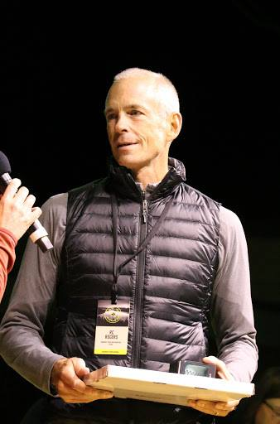
RC Rogers
2017 BARR Championship Series
REI has made a generous donation to the WSBA in memory of its employee and WSBA member RC Rogers (Dyna Racing), who passed away unexpectedly on September 20, 2016.
The 2017 BARR series will be named for RC.

Slide 16
2016
Slate of Candidates
East region representative: Ted Chauvin
West region representative: David Hills
USAC officials representative: Al Cronin
Track representative: Eric Johnson
Oregon representative: Paul Bourcier
Cyclocross director: Kevin Raymond
Directors on the Board are elected for three-year terms by a vote of the membership (one vote per USAC club in Washington, North Idaho, and Oregon who are present at the meeting), conducted at the annual meeting.

